Slide 1

Diabetes Prediction using Machine Learning
Project By: Guide:
Amol Sudokar Dr. D. G. Harkut
Vaishnavi Khare
Trupti Ambuskar
Aniket Dudhe
Department of Computer Science and Engineering
Prof Ram Meghe college of Engineering and Management
Badnera- Amravati, India.
2022-2023

Slide 2
Content
Introduction
Literature review
Problem Identification
Proposed Ideas(Algorithms)
Hardware/Software Requirements
Work done till now
Conclusion
References

Slide 3
Introduction
Diabetes is rapidly growing nowadays in individuals, particularly young peoples and become major challenge for the researcher, scientist and educationist.
It is not only a disease but also a creator of different kind of disease like heart attack, blindness, kidney diseases, etc.
The main reason of diabetes is increase in the amount of sugar in the blood.
The normal identifying process is that patients need to visit a diagnostic center, consult their doctor, and sit tight for a day or more to get their report.
The number of report of diabetic patients is escalating day by day, due to innumerable reasons toxic or chemical contents mixed with the food, obesity, working culture and bad diet plan, unusual life style, eating food habits and environmental factors. Hence diagnosing of diabetes is essential to save the human lives.
Machine learning techniques can be used to developed an efficient healthcare system to predict a different type of diabetes diseases in advance.

Slide 4
What is the use of Machine Learning
Machine learning a subset of artificial intelligence (AI), which is used to perform complex tasks in a way that is similar to how humans solve problems.
The concept of machine learning has quickly become very attractive to the healthcare industry.
In machine learning, the types of algorithms that can help make decisions and predictions.
Machine learning is a growing technology which enables computers to learn automatically from past data. Machine learning uses various algorithms for building mathematical models and making predictions using historical data or information.
With the help of sample historical data, which is known as training data, machine learning algorithms build a mathematical model that helps in making predictions or decisions without being explicitly programmed.
Currently, it is being used for various tasks such as image recognition, speech recognition, email filtering, Facebook auto-tagging, recommender system, and many more.

Slide 5
Literature review
Machine Learning Techniques are becoming more useful in the medical sector. Many researchers have used various machine Learning and deep learning Techniques and Algorithms to predict diabetes.
Sr no. | ORIGINATOR WITH TITLE | DATASET | ALGORITHM | TOOL | OUTCOME & ACCURACY
1. | Aishwarya Iyar, S. jeyalatha and RonakSumbaly, “Diagnosis Of Diabetes Using Classification Mining Techniques” | Pima Indians Diabetes Database of National Institute of Diabetes and Digestive and Kidney Diseases | Decision tree and Naïve Bayes algorithm | WEKA | The Naïve Bayes algorithm is obtained 79.5652% of accuracy
2. | AkankashaRathore, Simran Chauhan, SakshiGujral, “Detecting and Predicting Diabetes Using Supervised Learning: An Approach towards Better Healthcare for Women” | Pima | SVM and Decision Tree | R-Studio | SVM gives the 82% of accuracy

Slide 6
Literature Review
Sr no. | ORIGINATOR WITH TITLE | DATASET | ALGORITHM | TOOL | OUTCOME & ACCURACY
3. | Salim Amour Diwani studied all patients data are trained and tested using 10 cross validation, then performance was evaluated, investigated and compared with other classifications algorithms | Pima | Naïve Bayes and Decision tree algorithm | WEKA | The result predicted that the best algorithm is Naïve Bayes with an accuracy of 76.3021%
4. | N. P. Tigga applied logistic regression on PIDD for diabetes Prediction | Pima Indians Diabetes dataset | Logistic Regression algorithm | R-Studio | Good prediction with an accuracy of 75.32%
5. | Q. Zou applied RF, DT, ANN for classification algorithms on PIDD after the feature reduction using Principle components analysis (PCA) and minimum redundancy maximum relevance(mRMR) methods. | Pima Indians Diabetes Dataset | Random Forest, Decision Tree | Not mention-ed | Best accuracy is 77.21% obtained from the random forest with the mRMR feature reduction methods.

Slide 7
Problem Identification
Diabetes is a most common disease caused by a group of metabolic disorders. It is also diabetic mellitus.
It affects the organs of human body. It can be controlled by predicting this disease earlier.
Now a days, healthcare industries generating large volume of data. Machine learning algorithms and statistics are used to predict the diseases with the help of current and past data.
Machine learning techniques helps the doctors to predict early stage for diabetics.
Diabetics patients medical record and different types of algorithms are added in datasets for experiential analysis.
We used Random forest, Decision tree, Support vector machine (SVM) and Logistic regression to predict whether a patient has diabetes based on diagnostic measurements.
Performance and accuracy of the applied algorithms is discussed and compare.

Slide 8
Types of Diabetes
Diabetes can be divided into two classes: Type 1 and Type 2
Type 1 affects 10% of everyone with diabetes. while type 2 diabetes affects about 90%.
The main thing to remember is that both are as serious as each other. Having high blood glucose(sugar) levels can leads to serious health complications, no matter whether you have type 1 or type 2 diabetes.
In Type 1, your body attacks the cells in your pancreas which means it cannot make any insulin.
Type 1 diabetes can appear at any age but its most common among children and adolescents.
In Type 2, the body still produce insulin, but its unable to use it effectively.
Type 2 diabetes can appear at over age of 45, have a lots of belly fats, are carrying access weight or have obesity.
So if you have either conditions, you need to take the right steps to manage it.

Slide 9
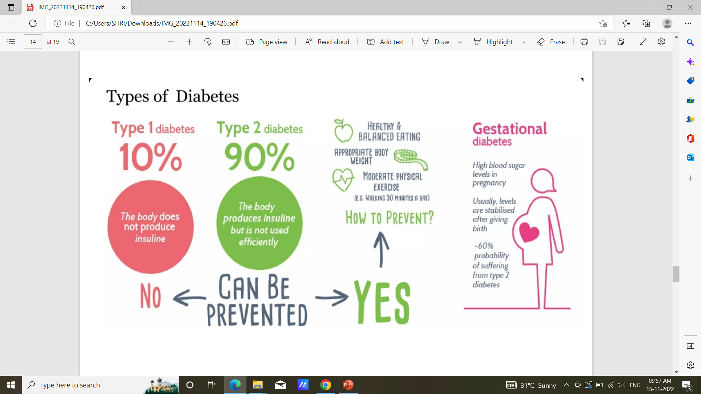

Slide 10
Proposed Ideas
Dataset collection :- It includes collection of understanding data to study the hidden patterns and trends which helps to predict and evaluating the results. Dataset carries number of rows (i.e. total number of data) and number of columns (i.e. total number of attributes).
Data Pre-processing : - This phase of model handles inconsistent data in order to get a more accurate and precise result like in this dataset is inconsistent so we dropped the feature. This dataset doesn't content missing values. So we imputed missing value for few selected attributes.
Missing Value Identification : - Using the pandas library and SK-learn, we got the missing values in datasets. we replace this missing value with the corresponding mean value i.e. zero.
Scaling and normalization :- We performed features scaling by normalizing the data from 0 to 1 range, which boosted the algorithms calculations speed.
Feature Selection :- Pearson’s correlation method is popular method to find most relevant attributes/features. The coefficient value remains in a range between -1 and 1. The value above 0.5 and below -0.5 indicates a notable correlation, and the zero value means no correlation.

Slide 11
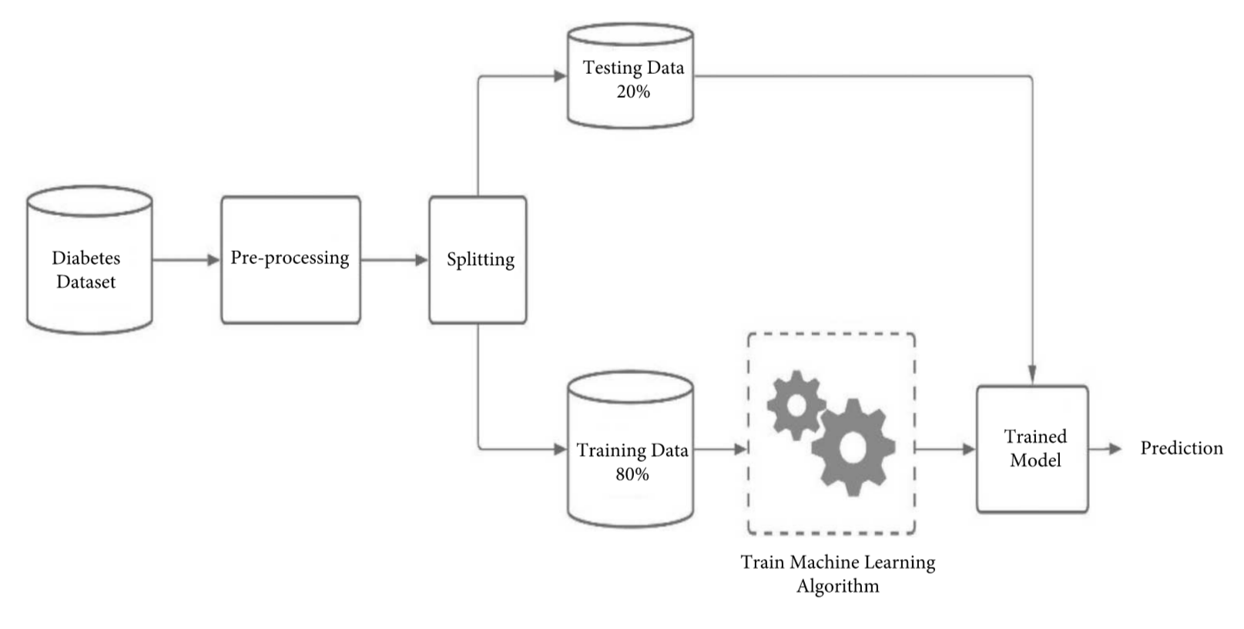
Proposed System

Slide 12
Algorithms
Logistic Regression :- It is machine learning technic used when dependent variables are able to categorize. It used probabilistic estimations which helps in understanding the relationship between the dependent and one or more independent variable.
K-nearest neighbors(KNN) :- It uses feature similarity to predict the values of new data points which further means that the new data point will be assigned a value based on how closely it matches the points in the training sets.
Support Vector Machine(SVM) :- SVM are set of supervised learning methods used for classification, regression and outliers detection. In SVM we have to identify the right hyper plane to classify the data correctly.
Decision Tree :- Decision tree is non parametric classifier in supervised learning . In this method all the details are represented in the form of tree, where leaves are corresponds to the class labels and attributes are corresponds to internal node of the tree. We have used Gini Index for splitting the nodes.
Random forest :- Random forest is the popular supervised learning technique. It is a process of combing multiple classifiers to solve complex problem and to improve performance of the model.

Slide 13
Random Forest Algorithm
Random forest algorithm used for both classification and regression problems in ML.
It predicts output with high accuracy, even for the large dataset it runs efficiently.
Random forest is a classifier that contains number of decision trees on various subsets of the given dataset and takes average to improve the predictive accuracy of that datasets.
The greater number of trees in the forest leads to higher accuracy and prevents the problem of overfitting.
Why we use random forest algorithm:
This algorithm takes less training time as compared to other algorithms.
This algorithms predicts output with high accuracy, even for the large dataset it runs efficiently.
It can also maintain accuracy when a large proportion of data is missing.

Slide 14
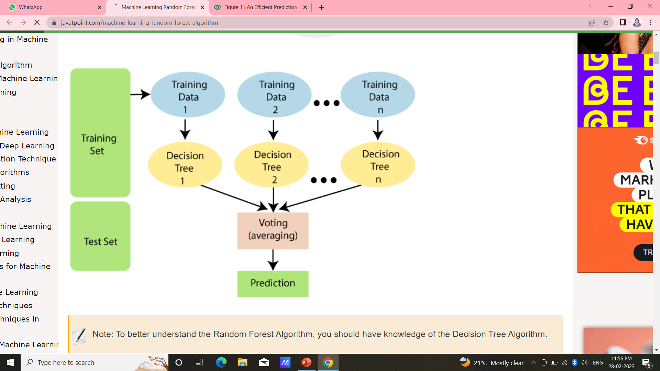
In random forest algorithm combines a multiple trees to predict the class of dataset, it is possible that some decision trees may predict the correct output, while others may not.
But together, all the trees predict the correct output. Therefore, below are two assumptions for better random forest classifier :
There should be some actual values in the feature variables of the dataset so that classifier can predict accurate results rather than a guessed result.
The predictions from each tree must have very low correlations.

Slide 15
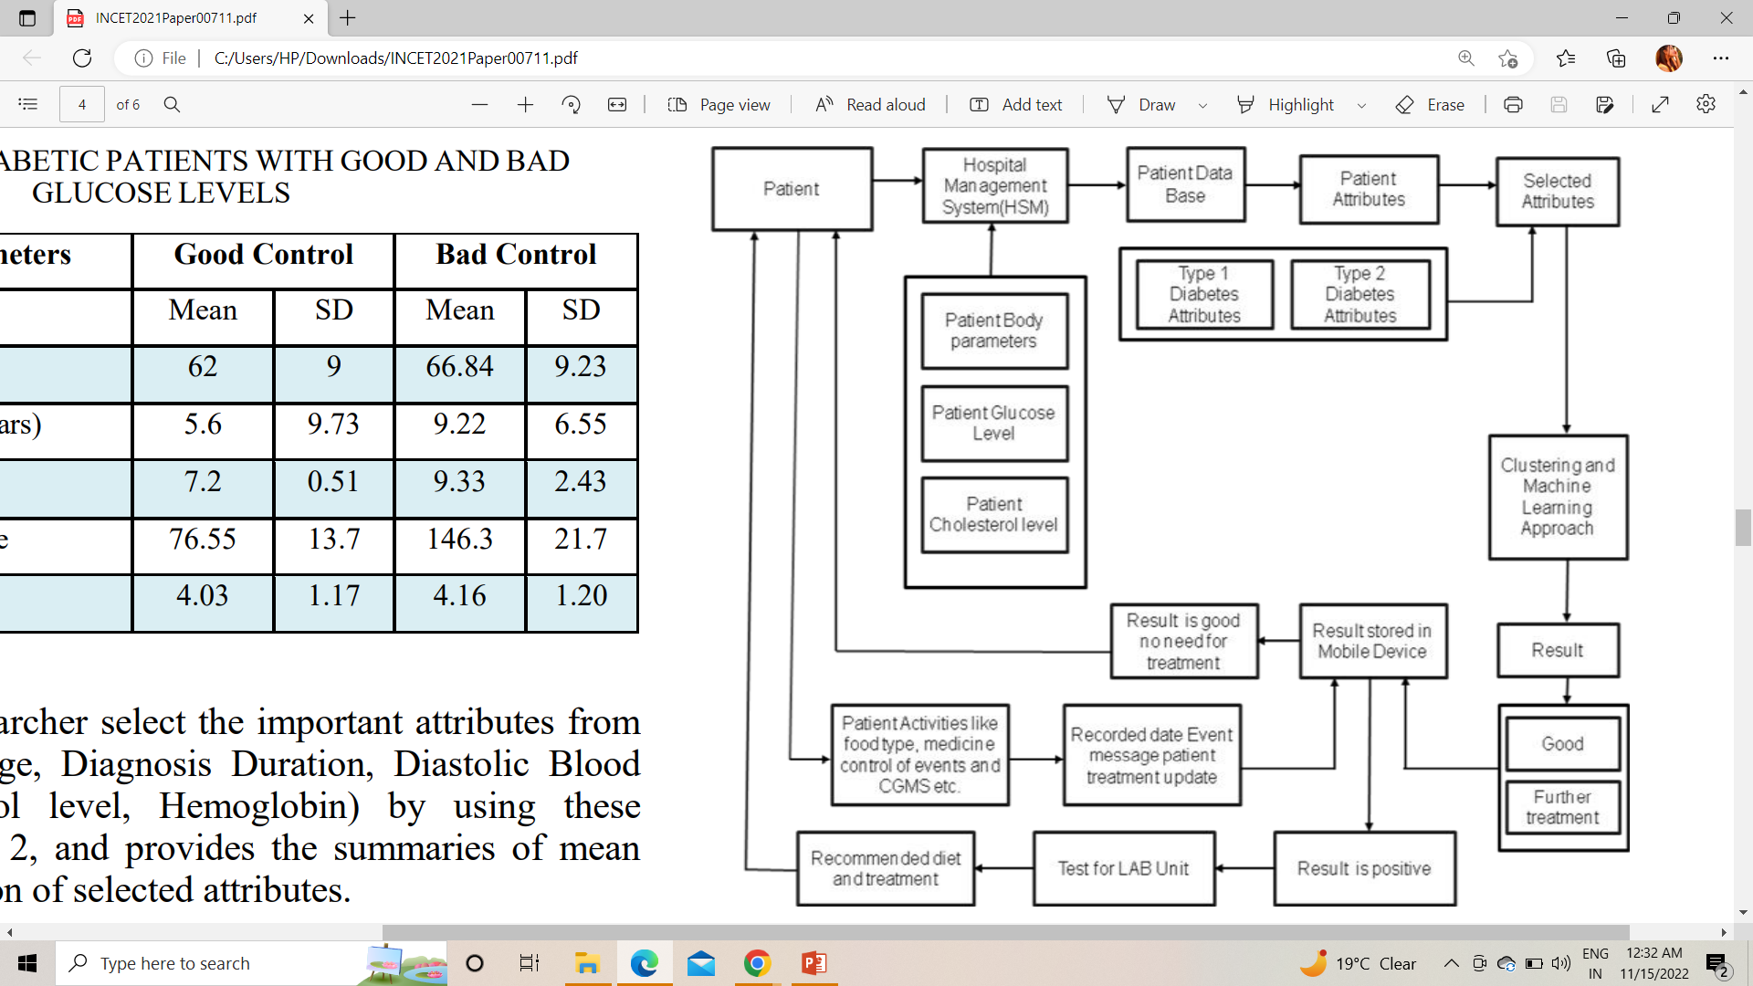
Machine Learning Diabetes Prediction

Slide 16
Hardware/Software Requirements
Hardware requirements:-
Processor core i5
Ram 8GB
Software requirements:-
Operating system:- Windows 10
Language:- Python programming language (for backend)
HTML/CSS (for frontend)
IDE Platform-Visual Studio
Libraries- NumPy, pandas, Matplotlib, sklearn, seaborn

Slide 17
Work done till now
Importing Libraries :-
NumPy :- NumPy stands for numerical python. It is a python library used for working with arrays. It has functions for working in domain of linear algebra and matrices.
Pandas :- Pandas is a python library used for working with dataset. It has functions for analysing, cleaning , exploring and manipulating data.
Matplotlib :- Matplotlib is a cross-platform, data visualization and graphical plotting library for python and its numerical extension NumPy.
Sklearn :- Scikit-learn is a key library for python programming language that is focused on machine learning tools including mathematical, statistical and general purpose algorithms that form basis for many machine learning technologies.
Seaborn :- It is python data visualization library based on matplotlib. It provides high level interface for drawing attractive and informative statistical graphics.
We will be reading the dataset which is in the CSV format
dataframe=pd.read_csv(‘diabetes_prediction/dataset.csv’)

Slide 18
Pre-processing of data:-
Display dataset information using method dataframe.info()
Checking null data in dataset using method dataframe.isnull()
Display dataset attributes in Histogram format.
Display Heatmap for null values.
Find correlation between attributes.
4. Model Building
Splitting the dataset (Testing data and Training data)
Building model and Checking Accuracy level of different Algorithm:
a) Random forest – 80% Accuracy level
b) Logistic Regression – 79%
c) Decision Tree – 76%
d) XGBOOST – 74%
e) Support Vector Machine(SVM)- 77%

Slide 19
Conclusion
The main aim of this project is to design and implement Diabetes Prediction using Machine Learning Method and Performance Analysis of that methods and it has been achieved successfully.
After using all the patient records we are able to build a machine learning model( Random forest algorithm is the best one which have highest accuracy) to accurately predict whether or not the patients in the datasets have diabetes or not along with that we were able to draw some insights from the data via data analysis and visualization.

Slide 20
References
[1] Berger, Ashton C., et al. "A comprehensive pan-cancer molecular study of gynecologic and breast cancers." Cancer cell 33.4 (2018): 690-705.
[2] Dean, Laura, and Jo Mc Entyre. "Introduction to Diabetes" The Genetic Landscape of Diabetes [Internet].National Centre for Biotechnology Information (US), 2004
[3] Khaleel, Mohammed Abdul, Sateesh Kumar Pradham, and G. N. Dash. "A survey of data mining techniques on medical data for finding locally frequent diseases" International Journal of Advanced Research in Computer Science and Software Engineering 3.8 (2013): 149-153.
[4] Zhao, Chunhui, and Chengxia Yu. "Rapid model identification for online subcutaneous glucose concentration prediction for new subjects with type I diabetes." IEEE Transactions on Biomedical Engineering 62.5 (2015): 1333-1344
[5] https://www.who.int/health-topics/diabetes.
[6] https://www.medicalnewstoday.com/articles/325018#how-is-the-pancre as-linked-with-diabetes.
[7] https://www.webmd.com/diabetes/diabetes-causes.
[8] https://www.mayoclinic.org/diseases-conditions/prediabetes/diagnosis-t reatment/drc-20355284.
[9] Q. Zou, K. Qu, Y. Luo, D. Yin, Y. Ju, H. Tang, Predicting Diabetes Mellitus with Machine Learning Techniques, Vol. 9, Frontiers in genetics, 2018, p. 515, http://dx.doi.org/10.3389/fgene.2018.00515.
[10] S. Perveen, M. Shahbaz, A. Guergachi, K. Keshavjee, Performance analysis of data mining classification techniques to predict diabetes, Procedia Comput. Sci. 82 (2016) 115–121.

Slide 21
Thank you

